Slide 1

Faerie: Efficient Filtering Algorithms for Approximate Dictionary-based Entity Extraction
Guoliang Li (Tsinghua, China)
Dong Deng (Tsinghua, China)
Jianhua Feng (Tsinghua, China)

Slide 2
Outline
Motivation
Preliminaries
A Unified Framework
Heap-based Filtering Algorithm
Improving The Single-heap-based Method
Experiment
Conclusion

Slide 3
Named Entity Recognition
Dictionary-based NER
Dictionary of Entities
Documents
1 Sir Isaac Newton was an English physicist, mathematician, astronomer, natural philosopher, alchemist, and theologian and one of the most influential men in human history. His Philosophiæ Naturalis Principia Mathematica, published in 1687, is by itself considered to be among the most influential books in the history of science, laying the groundwork for most of classical mechanics.
2 Sigmund Freud was an Austrian psychiatrist who founded the psychoanalytic school of psychology. Freud is best known for his theories of the unconscious mind and the defense mechanism of repression and for creating the clinical practice of psychoanalysis for curing psychopathology through dialogue between a patient and a psychoanalyst.
Isaac Newton Sigmund Freud English Austrian physicist mathematician astronomer philosopher alchemist theologian psychiatrist economist historian sociologist ...

Slide 4
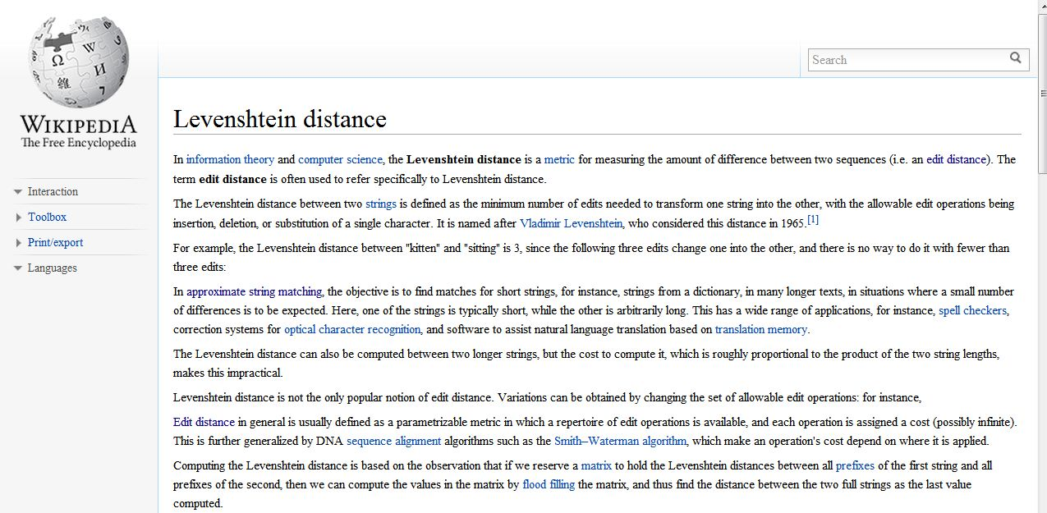
Automatically add the links
Wikipedia
http://en.wikipedia.org/wiki/Levenshtein_distance

Slide 5
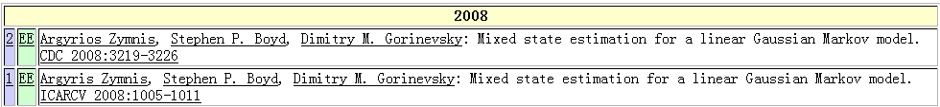
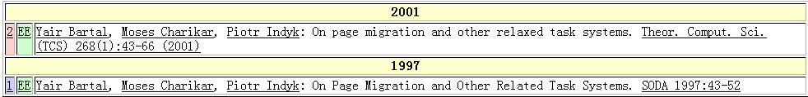
Real-world Data is Rather Dirty！☹
DBLP Complete Search
Typo in “author”
Typo in “title”
Argyrios Zymnis
Argyris Zymnis
relaxed
related

Slide 6
Approximate Entity Extraction
Approximate dictionary-based entity extraction finds all substrings from the document that approximately match the predefined entities.
For example:
Sigmund Freund was an Austrian psychiatrest who founded the psychoanalytic school of psychology. Freud is best known for his theories of the unconscious mind and the defense mechanism of repression and for creating the clinical practice of psychoanalysis for curing psychopathology through dialogue between a patient and a psychoanalayst.
Documents
Dictionary of Entities
Isaac Newton
Sigmund Freud
physicist
astronomer
alchemist
theologian
economist
sociologist ...

Slide 7
Outline
Motivation
Preliminaries
A Unified Framework
Heap-based Filtering Algorithm
Improving The Single-heap-based Method
Experiment
Conclusion

Slide 8
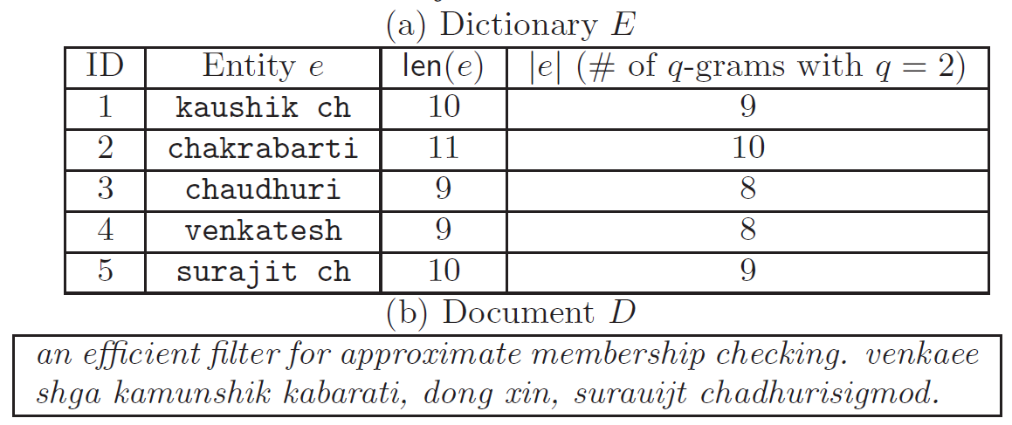
Problem Formulation
Approximate Entity Extraction: Given a dictionary of entities E = {e1, e2, . . . , en}, a document D, a similarity function, and a threshold, it finds all “similar” pairs <s, e_{i}> with respect to the given function and threshold, where s is a substring of D.
For example, if we use Edit Distance and threshold set to 2:

Slide 9
Similarity/Dissimilarity Function
Token-based Similarity:
  Jaccard Similarity
  Cosine Similarity
  Dice Similarity
Charater-based Dissimilarity:
  Edit Distance
Charter-based Similarity:
  Edit Similarity

Slide 10
Prior Work
NGPP
  Basic idea
    Partition the entity and guarantee two strings are similar only if there exist two partitions of two strings have an edit distance no larger than 1
  Can not support token-based similarity.
ISH
  Basic idea
    first selected top-weighted tokens as signatures and encoded the dictionary as a 0-1 matrix. Then built a matrix for the document and used the matrix to find candidates
  Can not support edit distance.
Call for a unified method to support various similarity/dissimilarity functions

Slide 11
Outline
Motivation
Preliminaries
A Unified Framework
Heap-based Filtering Algorithm
Improving The Single-heap-based Method
Experiment
Conclusion

Slide 12
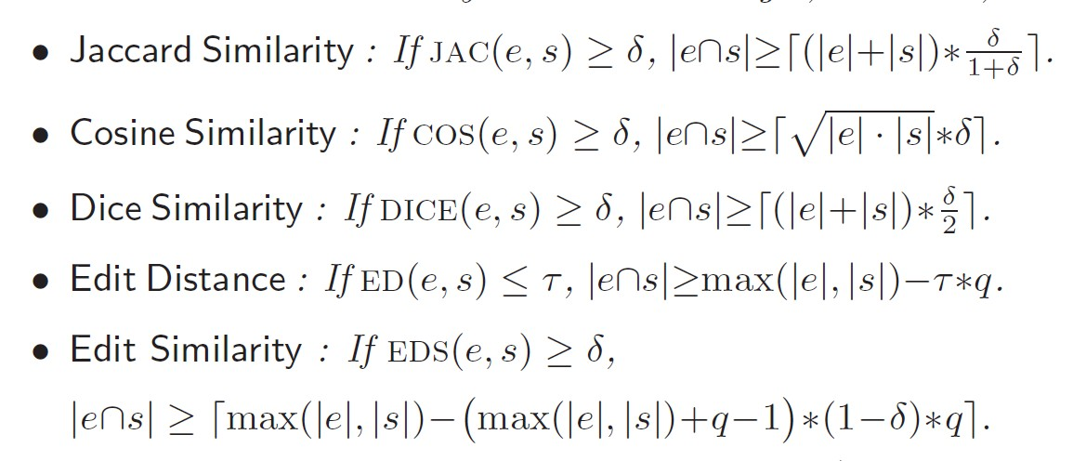
A Unified Framework
Transform different similarities to overlap similarity
A q-gram of a string s is a substring of s with length q

Slide 13
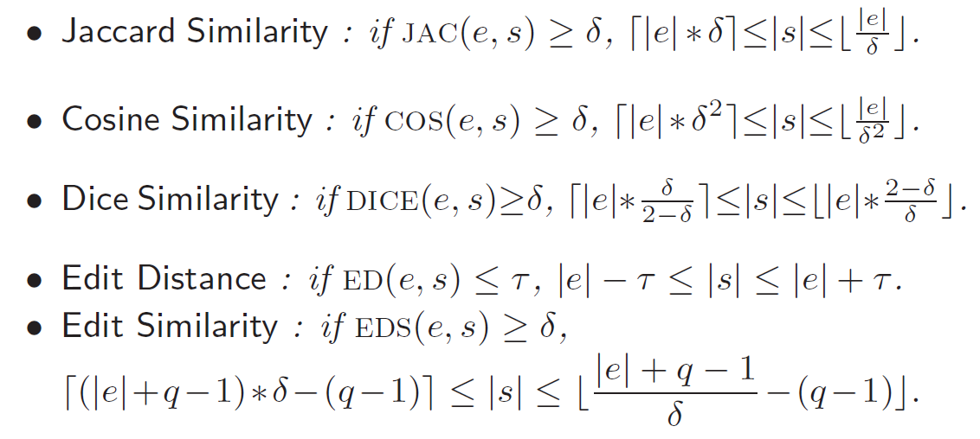
Valid Substrings
If string s is similar to string e, s’s length must be in a range.

Slide 14
Outline
Motivation
Preliminaries
A Unified Framework
Heap-based Filtering Algorithm
Improving The Single-heap-based Method
Experiment
Conclusion

Slide 15
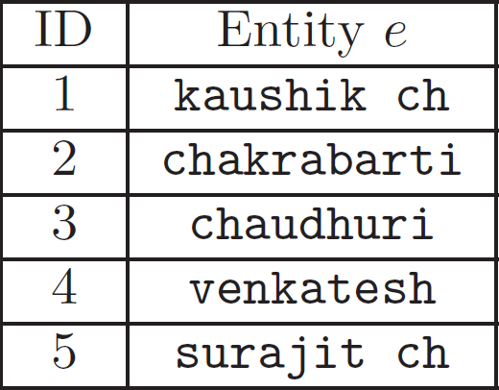
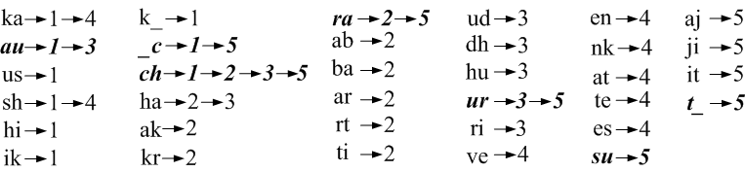
An Inverted Index Structure
A valid substring is similar to an entity only if they have enough common tokens (or q-grams).
Token-based Similarity
  Inverted index for all entities to count overlap
Character-based Similarity
  Inverted index for q-grams of entities to count overlap

Slide 16
Multi-Heap based Method
Step 1: Construct an inverted index for all entities

Slide 17
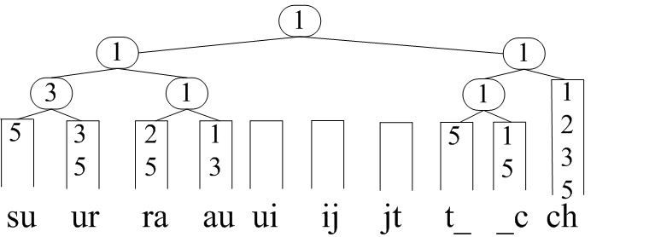
Multi-Heap based Method
Step 2: For each valid substring of D, construct a min heap using the first element of the inverted index.
Step 3 : For the top entity on the heap, count its occurrence number on the heap. Then adjust the heap, add the next entity of the inverted list to the heap and repeat Step 3
1, 1, 1, 2, 2, 3, 3, 3, 5, 5, 5, 5, 5, 5
an efficient filter for approximate membership checking. venkaee shga kamunshik kabarati, dong xin, surauijt chadhurisigmod.
Valid Substring
surauijt_ch

Slide 18
Multi-Heap based Method
Suppose edit distance threshold is 2:
ID | entity | Threshold | |e∩s| | Candidates?
1 | kaushik_ch | 6 | 3 | N
2 | chakrabarti | 6 | 2 | N
3 | chaudhuri | 6 | 3 | N
5 | surajit_ch | 6 | 6 | Y
Step 4: Verify the candidates

Slide 19
Problems of Multi-Heap based Method
Repeated computations as many substrings share common tokens or grams.
How to use the shared tokens or grams and avoid unnecessary computation?
We propose a single-heap based method.

Slide 20
Single-Heap based Method
Step 1: Construct an inverted index for all entities
Step 2: Build a single heap for the entire document using the first element of the inverted index.
Step 3: Adjust the heap, using a set of arrays to count the occurrence number of each entity in each valid substring.
Step 4: Verify the candidate pairs.

Slide 21
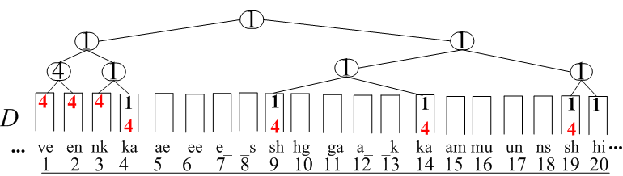
Single-Heap based Method
Step 2: Build a single heap for the entire document using the first element of the inverted index.

Slide 22
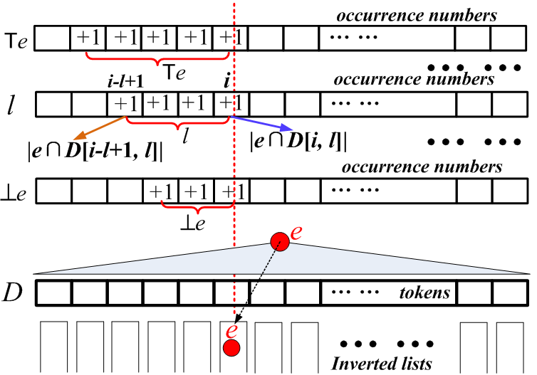
Single-Heap based Method
Step 3: Adjust the heap, using a set of arrays to count the occurrence number of each entity in each valid substring.

Slide 23
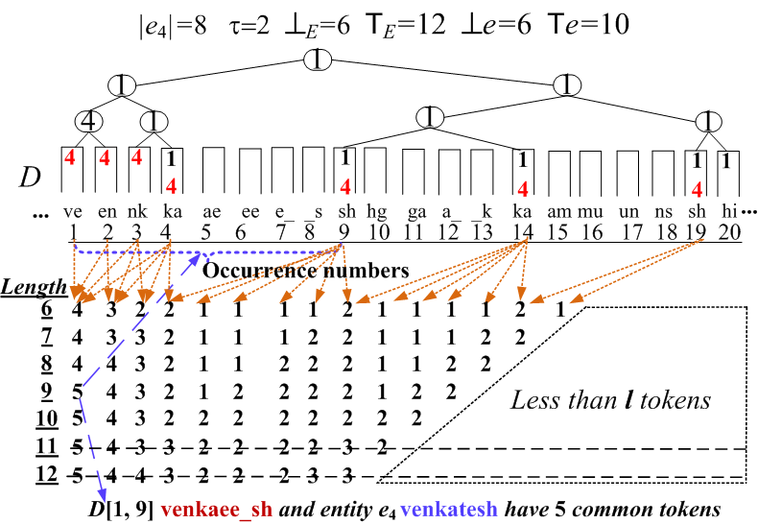
Single-Heap based Method
Step 3: Adjust the heap, using a set of arrays to count the occurrence number of each entity in each valid substring.

Slide 24
Outline
Motivation
Preliminaries
A Unified Framework
Heap-based Filtering Algorithm
Improving The Single-heap-based Method
Experiment
Conclusion

Slide 25
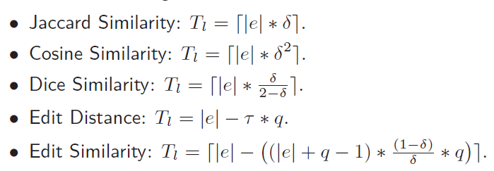
Pruning Techniques—Lazy Count
Lazy-Count Pruning gives a tighter bound of T, which only depends on |e| and the threshold.
For example, suppose threshold is 1.
|e₁| = 9. Tl = |e₁| − τ ∗ q = 9− 2 = 7.
As |Pe1| = 5 < Tl, e1 can be pruned.

Slide 26
Pruning Techniques—Bucket Count
Bucket-Count: We can divide the elements in Pe into two buckets and utilize lazy-count pruning respectively if their position difference is larger than Te - Tl.
Moreover, we can deduce a tighter bound for each different similarity fuction. For example we can set the max postion difference to τ* q.

Slide 27
Pruning Techniques—Bucket Count
For example, suppose tau = 1:
Pe4 = [1, 2, 3, 4, 9, 14, 19]
Tl = |e4|−τ ∗q = 8−1 ∗ 2 = 6 < |Pe4| ----> can’t prune.
p5 – p4 – 1 = 4 > τ * q = 2 ----> b1 = [1,2,3,4] ---> prune
p6 – p5 – 1 = 4 > τ * q = 2 ----> b2 = [9] ---> prune
p7 – p6 – 1 = 4 > τ * q = 2 ----> b3 = [14] - --> prune
b4 = [19] ---> prune

Slide 28
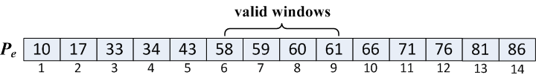
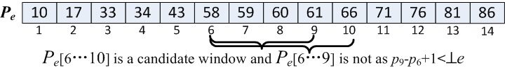
Pruning Techniques—Batch Count
Consider an entity e and its position list Pe = [p1 · · · pm]
If a valid substring is a candidate of entity e,
it must contain a candidate window
Pe[i · · · j] is called a valid window, if Tl ≤ |Pe[i · · · j]| ≤ e.
Next, we devise a efficient way to find candidate windows
Pe[i · · · j] is called a candidate window, if Pe[i · · · j] is a valid window and ⊥e ≤ |D[pi · · · pj ]| ≤ e.

Slide 29
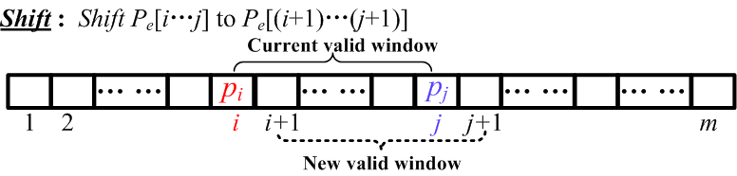
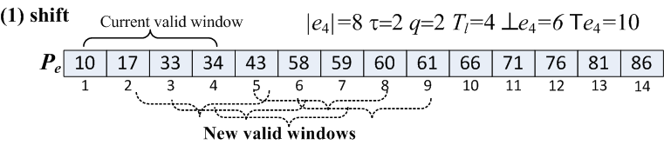
Finding Candidate Windows Efficiently
Shift:
If current valid window is not a candidate window, we shift to a new valid window Pe[(i+1)· · · (j+1)].

Slide 30
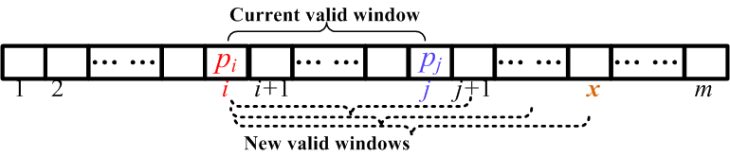
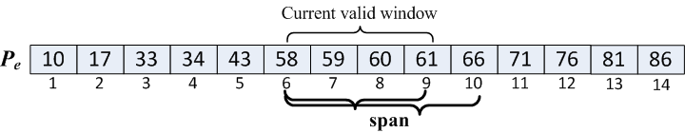
Finding Candidate Windows Efficiently
Span:
If current valid window Pe[i…j] is a candidate windows, then Pe[i…j+1] may be a candidate windows also. So we span Pe[i…j].

Slide 31
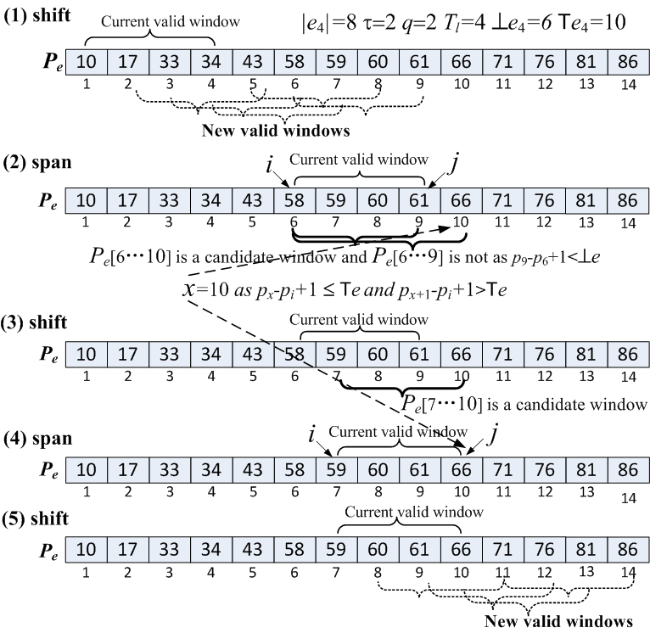
Finding Candidate Windows Efficiently

Slide 32
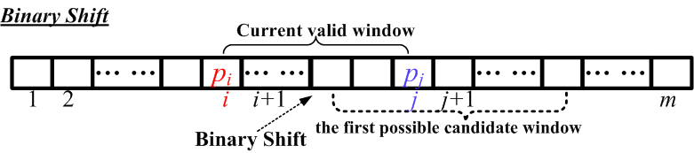
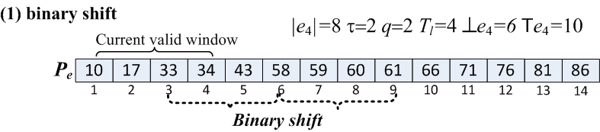
Finding Candidate Windows Efficiently
Binary shift:
We can do a binary search to find the first possible candidate window after current valid window

Slide 33
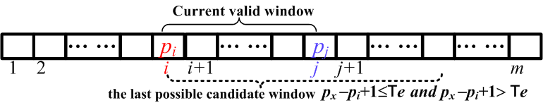
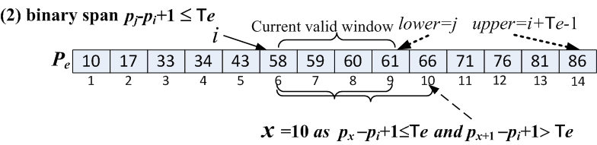
Finding Candidate Windows Efficiently
Binary span
We can do a binary search between j and i+e–1 and directly span to x.

Slide 34
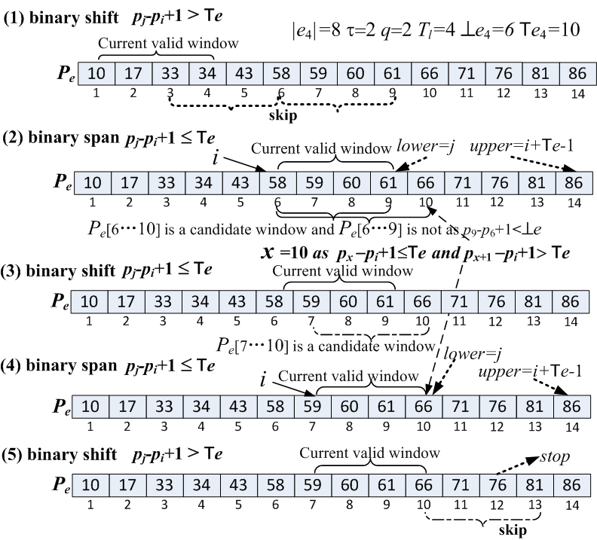
Finding Candidate Windows Efficiently

Slide 35
Outline
Motivation
Preliminaries
A Unified Framework
Heap-based Filtering Algorithm
Improving The Single-heap-based Method
Experiment
Conclusion

Slide 36
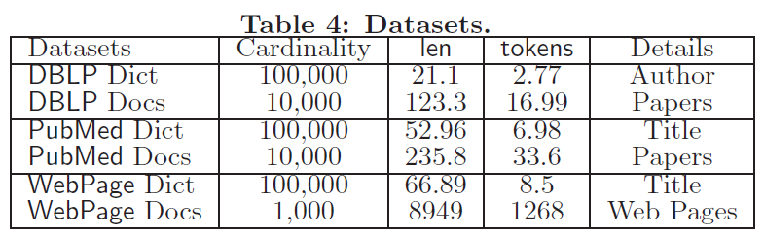
Experiment Setup
Data sets
Existing algorithms
    NGPP (downloaded from its hompage)
    ISH (we implemented)
Environment
    C++ , GCC 4.2.4, Ubuntu
    Intel Core 2 Quad X5450 3.00GHz processor and 4 GB memory

Slide 37
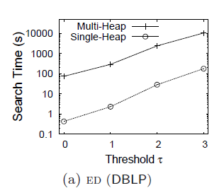
Multi-Heap vs Single Heap
single-heap-based method outperforms the multi-heap-based method by 1-2 orders of magnitude, and even 3 orders of magnitude in some cases

Slide 38
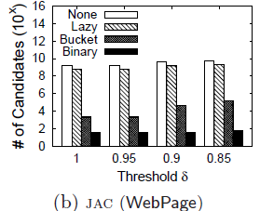
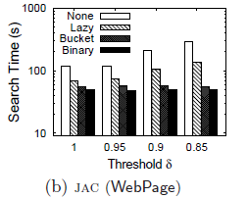
Effectiveness of Pruning Techniques
our proposed pruning techniques can prune large numbers of candidates and then save time

Slide 39
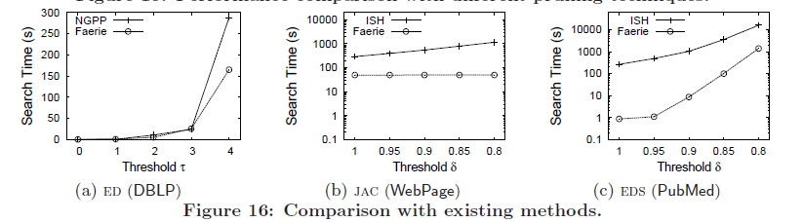
Comparison with State-of-the-art Methods
Faerie VS NGPP

Slide 40
Comparison with State-of-the-art Methods
Faerie VS ISH

Slide 41
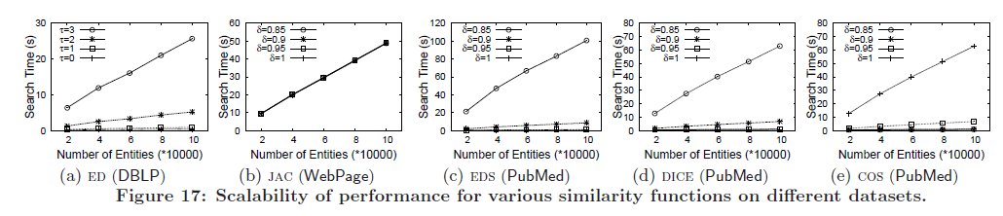
Scalability with Dictionary Sizes

Slide 42
Outline
Motivation
Preliminaries
A Unified Framework
Heap-based Filtering Algorithm
Improving The Single-heap-based Method
Experiment
Conclusion

Slide 43
Conclusion
  A unified framework to support various similarity functions.
  Heap-based filtering algorithms to efficiently extract similar entities from a document.
  A single-heap-based algorithm which can utilize the shared computation across overlaps of substrings
  Several pruning techniques to prune large numbers of unnecessary candidate pairs.
  The experimental results show that our method achieves high performance and outperforms state-of-the-art studies.

Slide 44

Thanks!
Q&A
http://dbgroup.cs.tsinghua.edu.cn/ligl/

Slide 45
Pruning Techniques—Batch Count
Consider an entity e and its position list Pe = [p1 · · · pm]. A sublist Pe[i · · · j] is called a window of Pe for 1 ≤ i ≤ j ≤ m. Pe[i · · · j] is called a valid window, if Tl ≤ |Pe[i · · · j]| ≤ e. Pe[i · · · j] is called a candidate window, if Pe[i · · · j] is a valid window and ⊥e ≤ |D[pi · · · pj ]| ≤ e.

Slide 46
Pruning Techniques—Batch Count
Consider an entity e and its position list Pe = [p1 · · · pm]. A sublist Pe[i · · · j] is called a window of Pe for 1 ≤ i ≤ j ≤ m. Pe[i · · · j] is called a valid window, if Tl ≤ |Pe[i · · · j]| ≤ e. Pe[i · · · j] is called a candidate window, if Pe[i · · · j] is a valid window and ⊥e ≤ |D[pi · · · pj ]| ≤ e.
Suppose τ = 2. Pe4 = [10, 17, 33, 34, 43, 58, 59, 60, 61, 66, 71, 76, 81, 86]
|e4| = 8, Tl = |e4| − τ ∗ q = 4. ⊥e4 = |e4| − τ = 6 and e4 = |e4| + τ = 10
Pe4 [1 · · · 4]=[10, 17, 33, 34] Pe4 [1 · · · 5]=[10, 17, 33, 34, 43]
Pe4 [6 · · · 9]=[58, 59, 60, 61] are valid windows
Pe4[1 · · · 4] is not a candidate window as p4−p1+1=34−10+1>e4
Pe4 [1 · · · 5] is not a candidate window as p5-p1+1>e4
Pe4[6 · · · 9] is not a candidate window as p9-p6+1<⊥e4

Slide 47
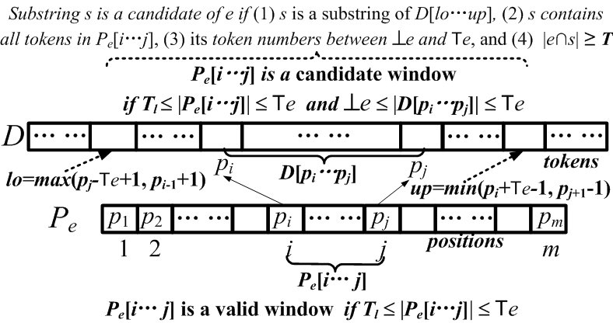
Pruning Techniques—Batch Count
Consider an entity e and its position list Pe = [p1 · · · pm]. A sublist Pe[i · · · j] is called a window of Pe for 1 ≤ i ≤ j ≤ m. Pe[i · · · j] is called a valid window, if Tl ≤ |Pe[i · · · j]| ≤ e. Pe[i · · · j] is called a candidate window, if Pe[i · · · j] is a valid window and ⊥e ≤ |D[pi · · · pj ]| ≤ e.
If a valid substring is a candidate of entity e,
it must contain a candidate window

